Slide 1
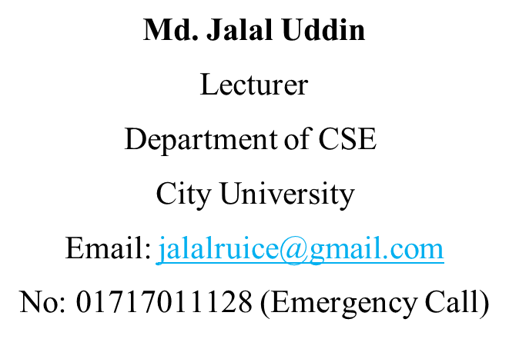
CSE-213
(Data Structure)
Lecture on
Recursion, Pointers and Records

Slide 2
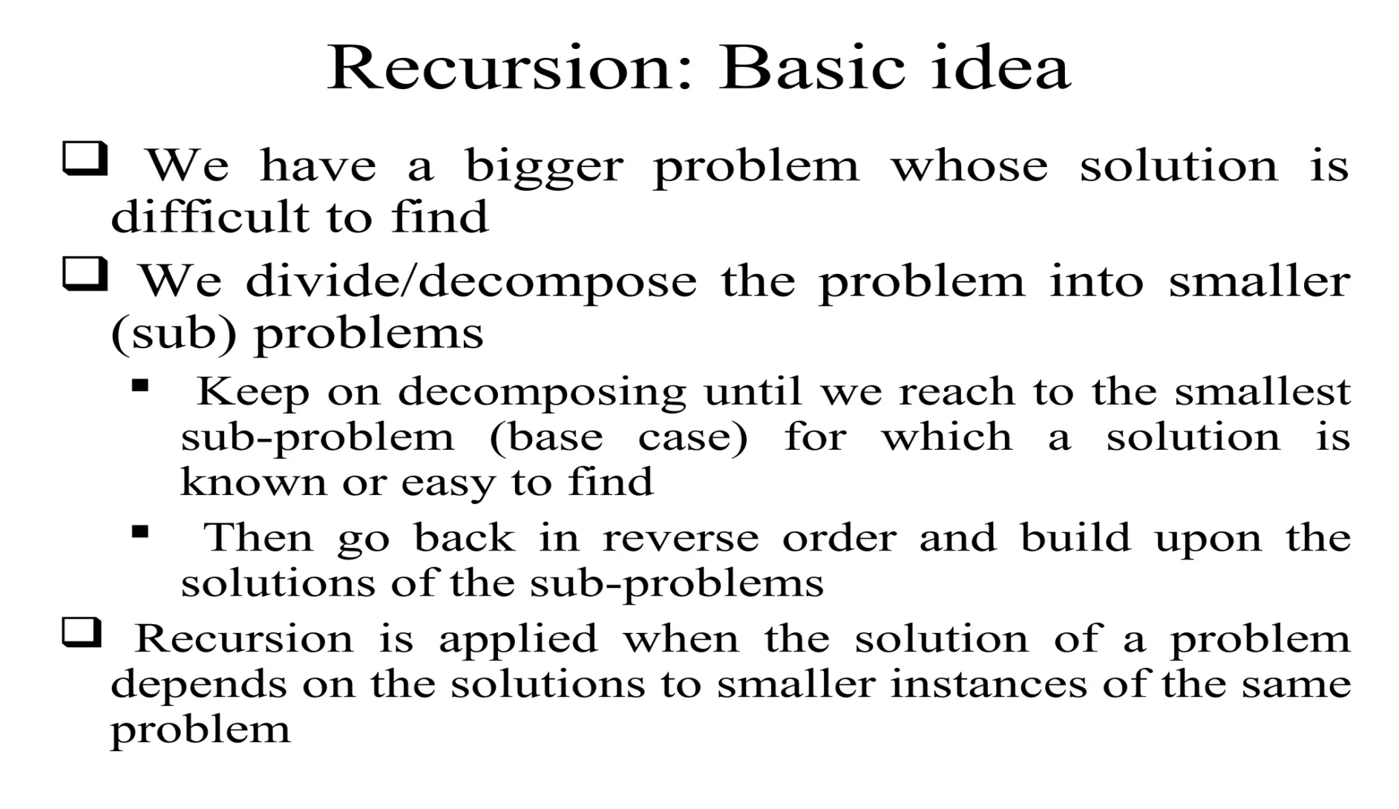
Recursion

Slide 3
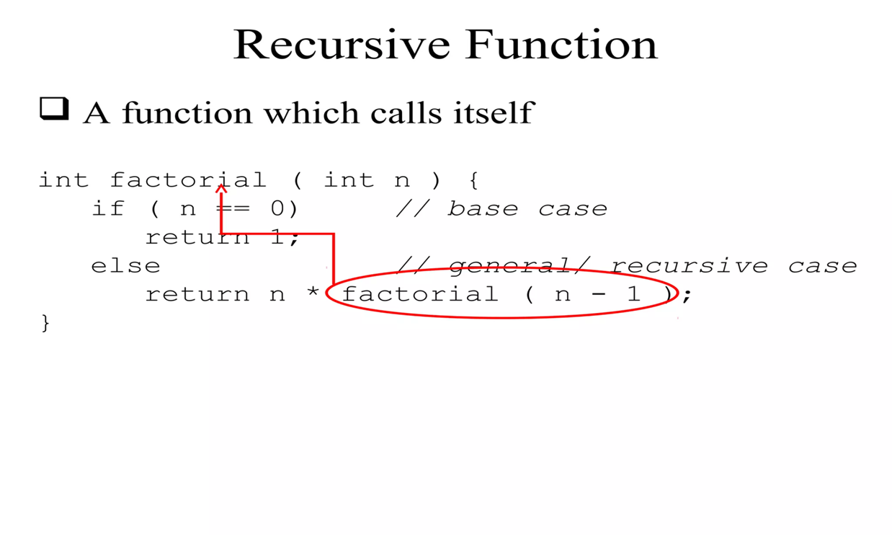
Recursion
Recursion in data structure is when a function calls itself indirectly or directly, and the function calling itself is known as a recursive function.
It's generally used when the answer to a larger issue could be depicted in terms of smaller problems.

Slide 4
Recursion: Function
A function is said to be Recursively defined if the function definition refers to itself.
A Recursive Function must have the following two properties:
There must be certain arguments, called BASE VALUE, for which the function does not refer to itself.
Each time the function does refer to itself, the argument of the function must be closer to a BASE VALUE.
A Recursive Function with two properties is also said to be well-defined.

Slide 5
Recursion: Factorial Function
In some problems, it may be natural to define the problem in terms of the problem itself.
Recursion is useful for problems that can be represented by a SIMPLER VERSION of the same problem.
Example: the factorial function
6! = 6 * 5 * 4 * 3 * 2 * 1
We could write:
6! = 6 * 5!

Slide 6
Recursion: Factorial Function
In general, we can express the factorial function as follows:
n! = n * (n-1)!
Is this correct? Well… almost.
The factorial function is ONLY DEFINED for positive integers. So we should be a bit more precise:
i) n! = 1 (if n is equal to 1)
ii) n! = n * (n-1)! (if n is larger than 1)
Observe that, this definition of n! is recursive, since it refers to itself when it uses (n-1)! , However,
i)the value of n! is explicitly given when n=0 (BASE VALUE)
ii)the value of n! for arbitrary n is defined in terms of a smaller value of n which is closer to the BASE VALUE

Slide 7
Recursion: Factorial Function
EXAMPLE: Let’s calculate 3! Using the recursive definition.
3! = 3 . 2!
2! = 2 . 1!
1! = 1 . 0!
0! = 1 (BASE VALUE)
1! = 1 . 1 = 1
2! = 2 . 1 = 2
3! = 3 . 2 = 6
Observe that we back track in the reverse order of the original postponded evaluations.
Recall that this type of postponed processing tends itself to the use of STACKS.
Notes:
Step 1. defines 3! In terms of 2!, so we must postpone evaluating 4! Until we evaluate 2!
Step 2. Here is 2! Is defined in terms of 1!, so we must postpone evaluating 3! Until we evaluate 1!
Step3. This defines 1! In terms of 0!.
Step4. This step can explicitly evaluate 0!, since 0 is the base value of the recursive definition.
Step 5~7 we back track, using 0! To find 1!, using 1! To find 2, using 2! To find 3!
This back tracking is indicated by the “reverse” indention.

Slide 8
Recursion: Function
Assume the number typed is 3, that is, numb=3.
fac(3) :
3 <= 1 ? No.
fac(3) = 3 * fac(2)
fac(2) :
2 <= 1 ? No.
fac(2) = 2 * fac(1)
n! = 1 (if n is equal to 1)
n! = n * (n-1)! (if n is larger than 1)
fac(1) :
1 <= 1 ? Yes.
return 1
int fac(int numb){
if(numb<=1)
return 1;
else
return numb * fac(numb-1);
}
fac(2) = 2 * 1 = 2
return fac(2)
fac(3) = 3 * 2 = 6
return fac(3)
fac(3) has the value 6

Slide 9
Recursion: Function
For certain problems (such as the factorial function), a recursive solution often leads to short and elegant code. Compare the recursive solution with the iterative solution:
Iterative solution
int fac(int numb){
int product=1;
while(numb>1){
product *= numb;
numb--;
}
return product;
}
Recursive solution
int fac(int numb){
if(numb<=1)
return 1;
else
return numb*fac(numb-1);
}

Slide 10
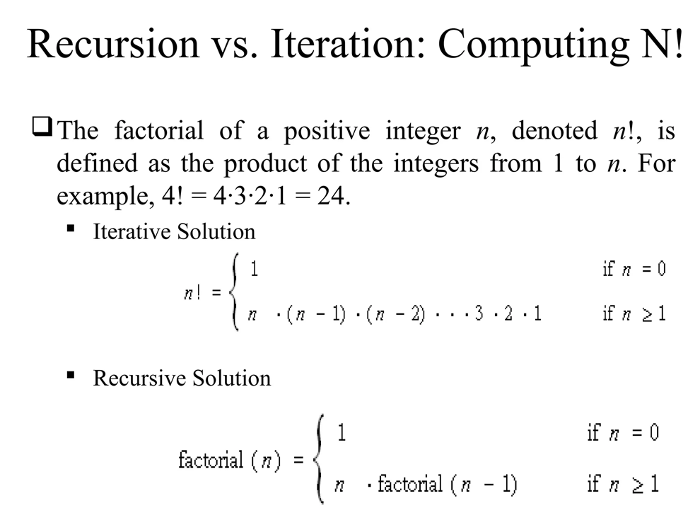
Iteration Vs Recursion
Two approaches to writing repetitive algorithms:
Iteration
Recursion

Slide 11
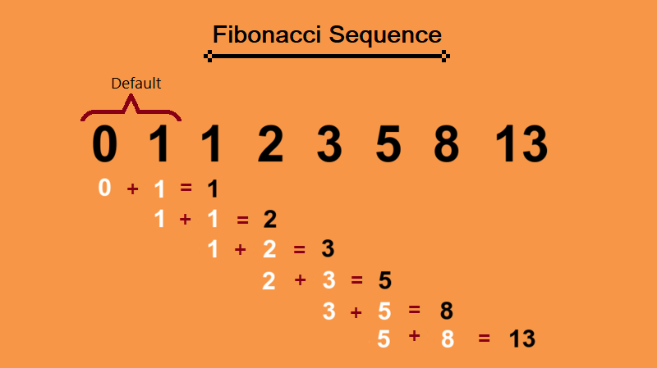
Recursion: Fibbonacc

Slide 12
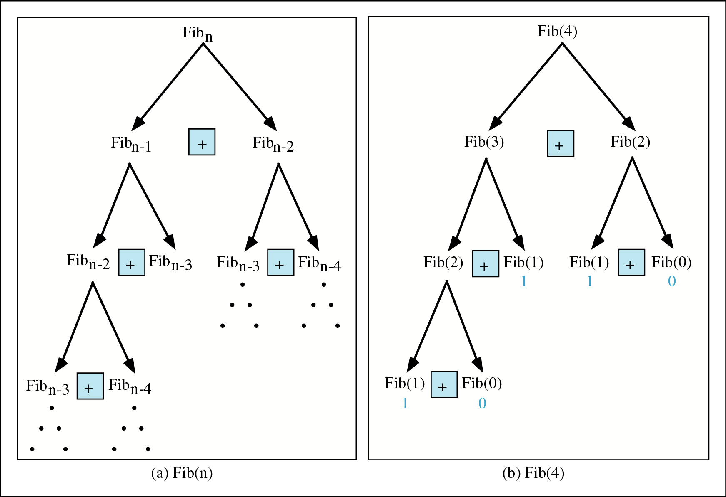
Recursion: Fibbonacci

Slide 13
Recursion: Fibbonacc
// Calculate Fibonacci numbers using recursive function.
// A very inefficient way, but illustrates recursion well
int fib(int number)
{
if (number == 0) return 0;
if (number == 1) return 1;
return (fib(number-1) + fib(number-2));
}
Recursive definition:
F(0) = 0;
F(1) = 1;
F(number)=F(number-1)+ F(number-2);

Slide 14
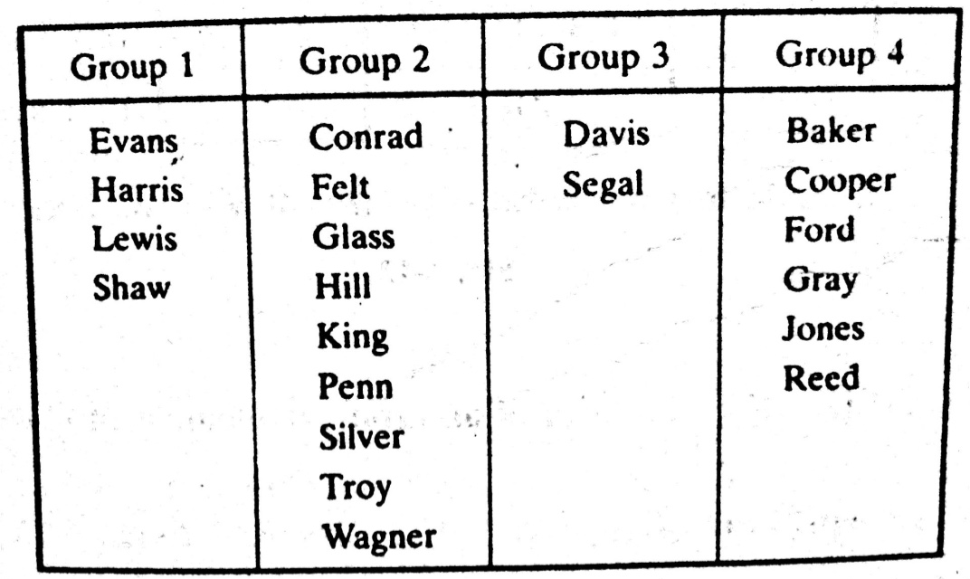
Pointers
Let DATA be any array. A variable P is called a pointer if P “points” to an element in DATA, i.e., if P contains the address of an element in DATA.
Pointer Arrays
An array PTR is called a pointer array if each element of PTR is a pointer
Pointer and Pointer array are used to facilitate the processing the information in DATA
How the membership list can be stored in memory keeping track of the different groups?
Notes:
Consider an organization which divides its membership list into four groups, where each group contains an alphabetized list of those member living in a certain area.

Slide 15
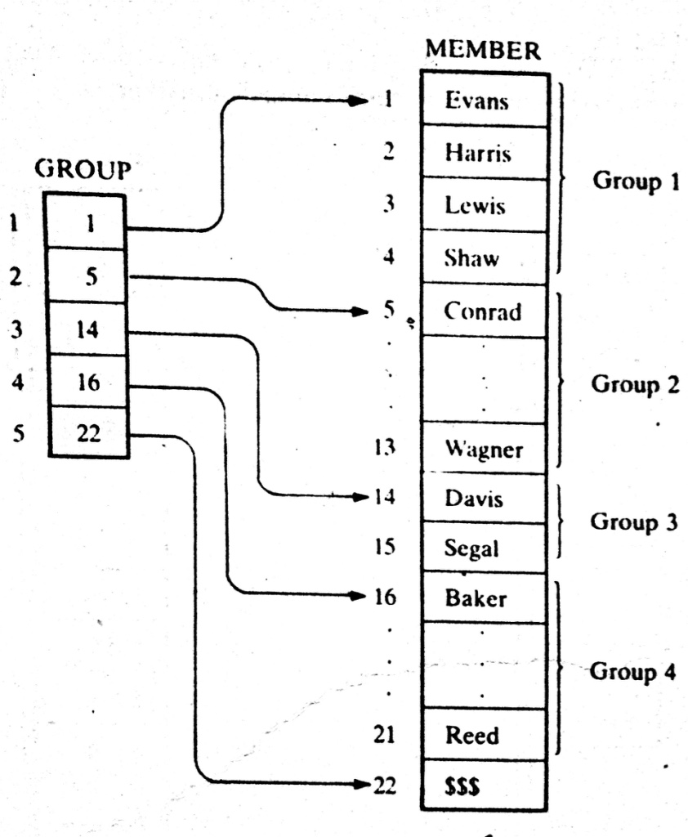
POINTER ARRAYS
Pointer arrays is introduced in the last two space-efficient data structure.
The pointer array contains the locations of the…..
Different groups, or
First element in the different groups.
GROUP[L] and GROUP[L+1]-1 contain respectively, the first and last element in group L.
Notes:
Here DATA is a linear array with N elements, and ITEN is a given item of information. This algorithm finds the location LOC of item in DATA, or sets LOC:=0 if the search is unsuccessful.

Slide 16
POINTER ARRAYS: Example
Suppose L=3
GROUP[L]=GROUP[3]= 14= Davis (1st Element of grp 3)
GROUP[L+1]-1=GROUP[3+1]-1=16-1=15= Segel (last element of grp 3)
Notes:
Here DATA is a linear array with N elements, and ITEN is a given item of information. This algorithm finds the location LOC of item in DATA, or sets LOC:=0 if the search is unsuccessful.

Slide 17
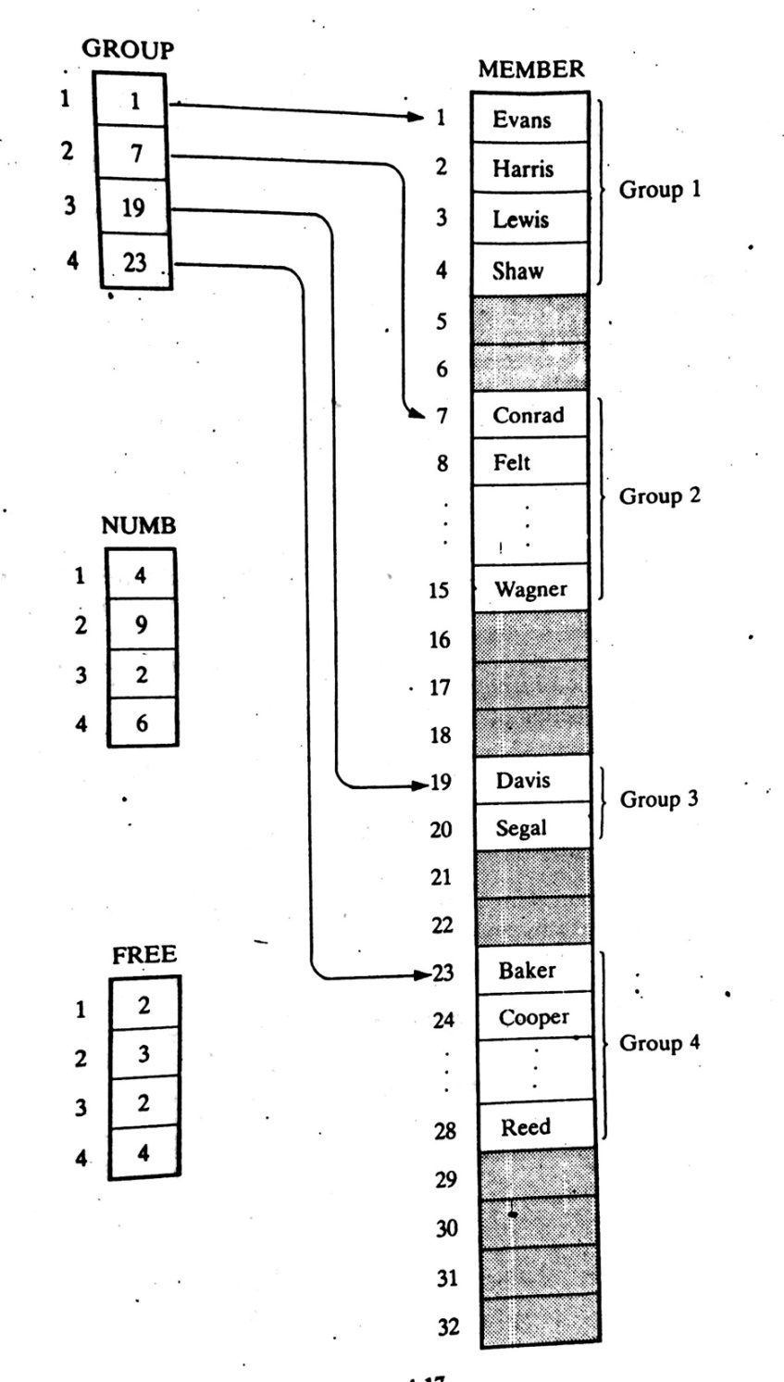
POINTER ARRAYS: Extended
Here unused memory cells are indicated by the shading.
Observe that now there are some empty cells between the groups.
Accordingly, a new element may be inserted in a new group without necessarily moving the elements in any other group.
Using the data structure, one requires an array NUMB which gives the number of elements in each group.
Observe that GROUP[K+1]-GROUP[K] is the total number of space available for group K. Hence
FREE[K]=GROUP[K+1]-GROUP[K]-NUMB[K]
Gives the number of empty cells following GROUP K
Notes:
Here DATA is a linear array with N elements, and ITEN is a given item of information. This algorithm finds the location LOC of item in DATA, or sets LOC:=0 if the search is unsuccessful.

Slide 18
POINTER ARRAYS: Extended, Example
Suppose, we want to print only the number of FREE cells of GROUP 2. Then
FREE[K]=GROUP[K+1]-GROUP[K]-NUMB[K]
FREE[2]=GROUP[2+1]-GROUP[2]-NUMB[2]
= 19-7-9
=3
For GROUP 4?
Try now
Notes:
Here DATA is a linear array with N elements, and ITEN is a given item of information. This algorithm finds the location LOC of item in DATA, or sets LOC:=0 if the search is unsuccessful.

Slide 19
RECORDS
A record is a collection of related data items, each of which is called a field or attribute, and
a file is a collection or similar records.
Although, a record is a collection of data items, it differs from a linear array in the following ways…............
A record may be a collection of nonhomogeneous data;
The data items in a record are indexed by attribute names, so there may not be a natural ordering of its elements.
Notes:
Here DATA is a linear array with N elements, and ITEN is a given item of information. This algorithm finds the location LOC of item in DATA, or sets LOC:=0 if the search is unsuccessful.

Slide 20
RECORDS: Structure Example
Newborn
2. Name
2. Sex
2. Birthday
3. Month
3. Day
3. Year
2. Father
3. Name
3. Age
2. Mother
3. Name
3. Age
Under the relationship of group item to sub- item, the data items in a record form a hierarchical structure which can be described by mean of “Level” numbers
Name | Sex | Birthday |  |  | Father |  | Mother
 |  |  |  |  | Name | Age | Name | Age
Notes:
Here DATA is a linear array with N elements, and ITEN is a given item of information. This algorithm finds the location LOC of item in DATA, or sets LOC:=0 if the search is unsuccessful.

Slide 21
Indexing Items in a Record
Suppose we want to access some data item in a record.
We can not simply write the data name of the item since the same may appear in different places in the record. For example…..
Newborn
2. Name
2. Sex
2. Birthday
3. Month
3. Day
3. Year
2. Father
3. Name
3. Age
2. Mother
3. Name
3. Age
In order to specify a particular item,
we may have to qualify the name by using appropriate group item names in the structure.
This qualification is indicated by using decimal points (periods) to separate group items from subitems.
Example: Newborn.Father.Age or Father.Age
Fully qualified reference
Notes:
Here DATA is a linear array with N elements, and ITEN is a given item of information. This algorithm finds the location LOC of item in DATA, or sets LOC:=0 if the search is unsuccessful.

Slide 22
Indexing Items in a Record
Newborn
2. Name
2. Sex
2. Birthday
3. Month
3. Day
3. Year
2. Father
3. Name
3. Age
2. Mother
3. Name
3. Age
Newborn(20)
2. Name
2. Sex
2. Birthday
3. Month
3. Day
3. Year
2. Father
3. Name
3. Age
2. Mother
3. Name
3. Age
Newborn is defined to be a file with 20 records
The Name of the sixth newborn to be referenced by writing …....
Newborn. Name[6]
The age of the father of the 6th newborn may be referenced by writing…..
Newborn.Father.Age[6]
Notes:
Here DATA is a linear array with N elements, and ITEN is a given item of information. This algorithm finds the location LOC of item in DATA, or sets LOC:=0 if the search is unsuccessful.

Slide 23
Representation of RECORDS in memory
Since records may contain nonhomogeneous data, the element of a record can not be stored in an array.
See Example: 4.18, 4.20, 4.21
Notes:
Here DATA is a linear array with N elements, and ITEN is a given item of information. This algorithm finds the location LOC of item in DATA, or sets LOC:=0 if the search is unsuccessful.

Slide 24
MATRICES and SPARSE MATRICES
Teach Yourself with example
Try to understand the SOLVED Problems
Notes:
Here DATA is a linear array with N elements, and ITEN is a given item of information. This algorithm finds the location LOC of item in DATA, or sets LOC:=0 if the search is unsuccessful.

